Slide 1
Matplotlib
Bob Xie Nov 2020

Slide 2

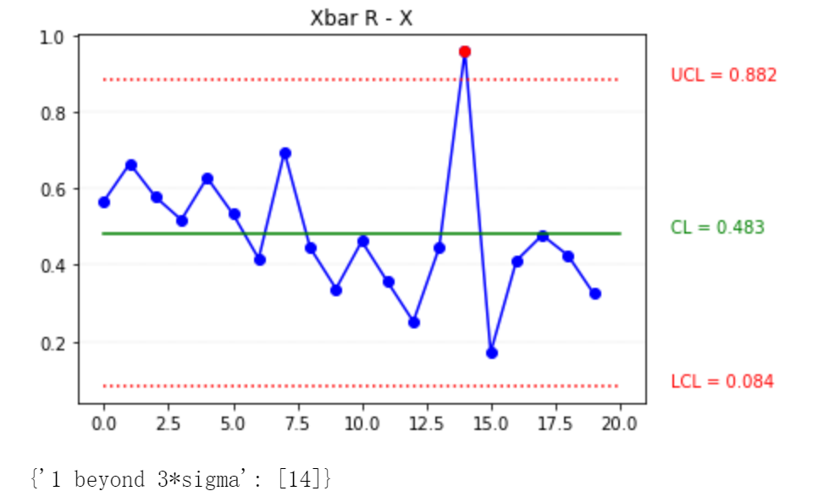
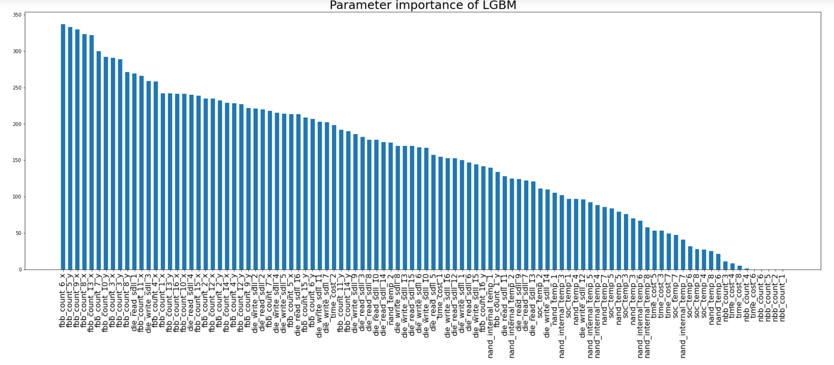
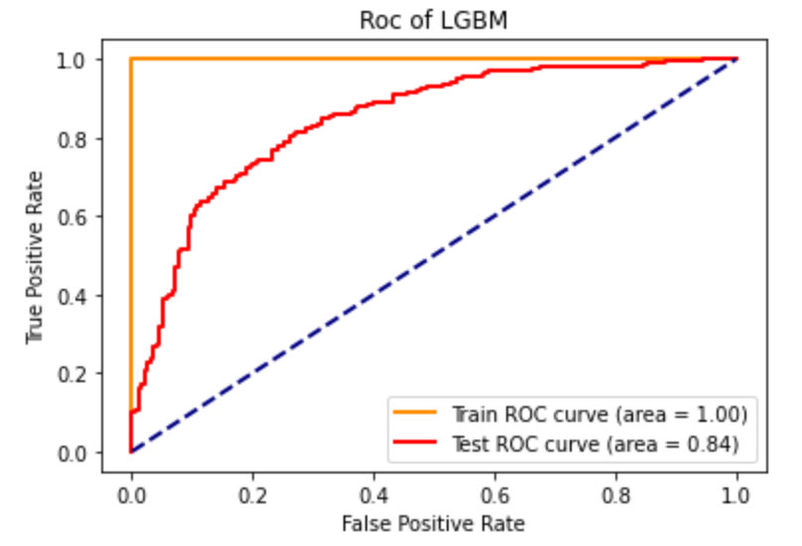
What’s Matplotlib
Matplotlib 是一个 Python 的 2D绘图库，它以各种硬拷贝格式和跨平台的交互式环境生成出版质量级别的图形。
-- 百度百科

Slide 3
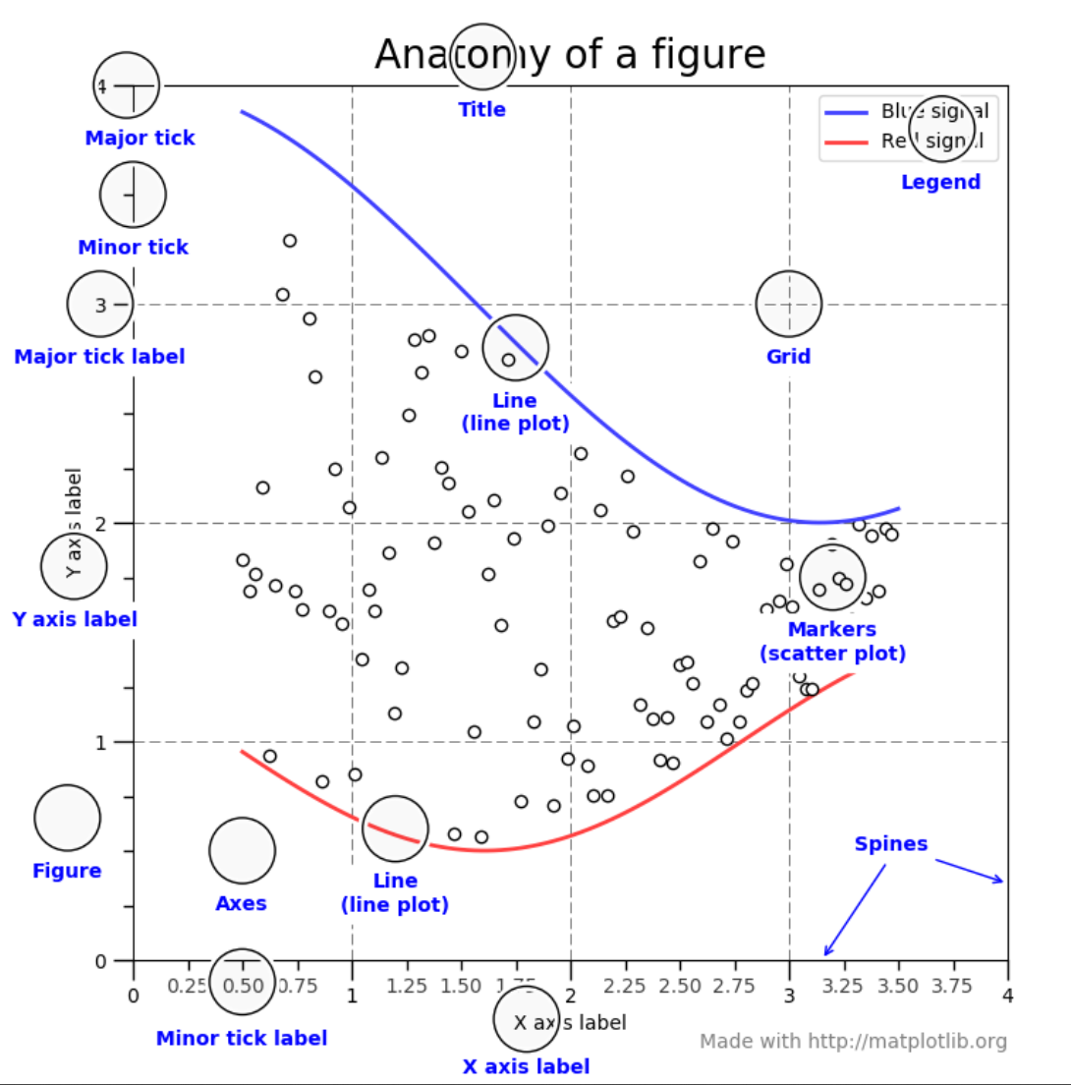
Figure’s components

Slide 4
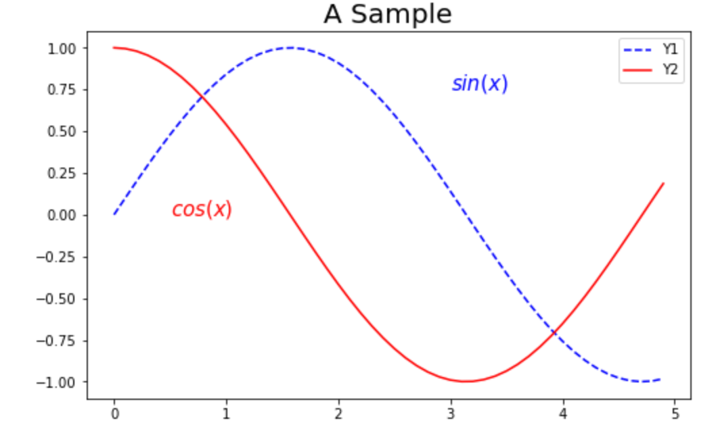
Matplotlib.pyplot.plot
import numpy as np
import matplotlib.pyplot as plt
x = np.arange(0, 5, 0.1)
y = np.sin(x)
plt.figure(figsize=(8,5))
plt.plot(x,y,'b--',label='Y1')
plt.plot(x,np.cos(x),'r',label='Y2')
plt.title('A Sample',fontsize=20)
plt.text(3,0.75,'$sin(x)$',fontsize=15,c='b')
plt.text(0.5,0,'$cos(x)$',fontsize=15,c='r')
plt.legend(loc="best")
plt.show()

Slide 5
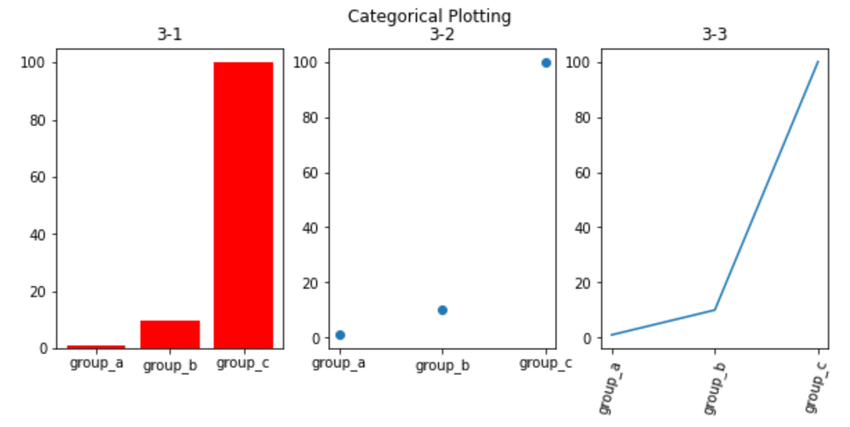
Matplotlib.pyplot.bar
import matplotlib.pyplot as plt
names = ['group_a', 'group_b', 'group_c']
values = [1, 10, 100]
plt.figure(figsize=(9, 4))
plt.subplot(131)
plt.bar(names, values,color='r')
plt.title('3-1')
plt.subplot(132)
plt.scatter(names, values)
plt.title('3-2')
plt.subplot(133)
plt.plot(names, values)
plt.xticks(rotation=75,fontsize=10)
plt.title('3-3')
plt.suptitle('Categorical Plotting')
plt.show()
给数据
画图
美化

Slide 6
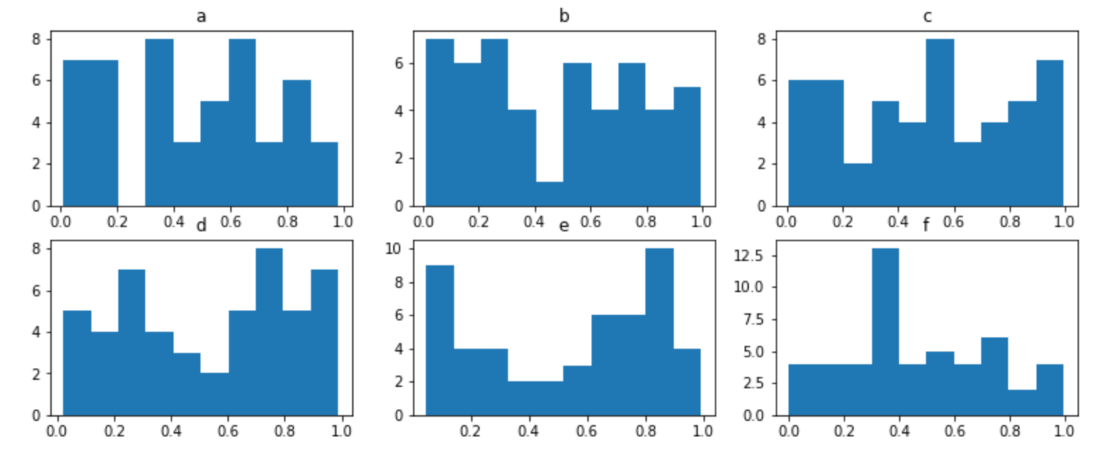
Matplotlib.pyplot.his
import matplotlib.pyplot as plt
import numpy as np
import pandas as pd
data=np.random.rand(300).reshape(50,6)
df=pd.DataFrame(data,columns=['a','b','c','d','e','f'])
def subplots(x,y,size):
fig,axes=plt.subplots(x,y,figsize=size)
return fig, axes
fig,axes=subplots(2,3,(13,5))
axes=axes.flatten()
for col,i in zip(df.columns,range(20)):
axes[i].hist(df[col])
axes[i].set_title(col)

Slide 7
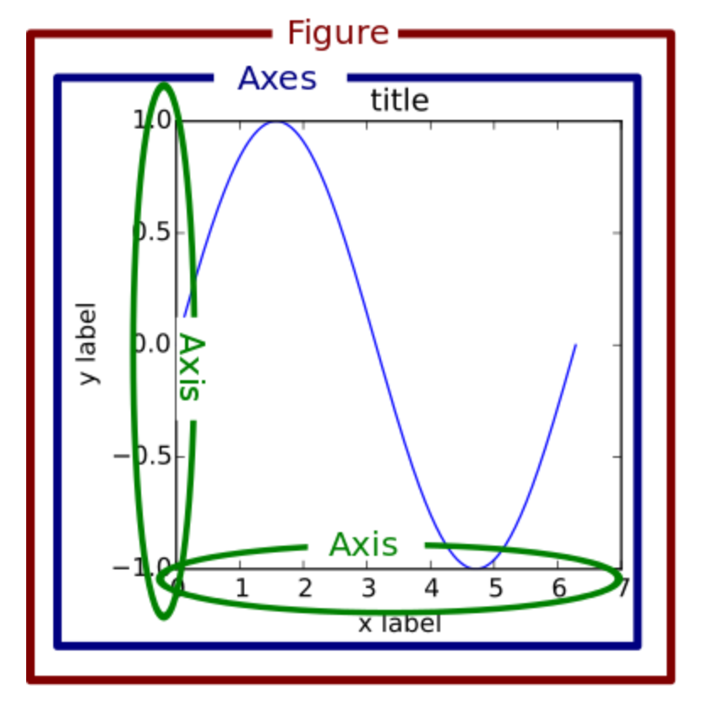
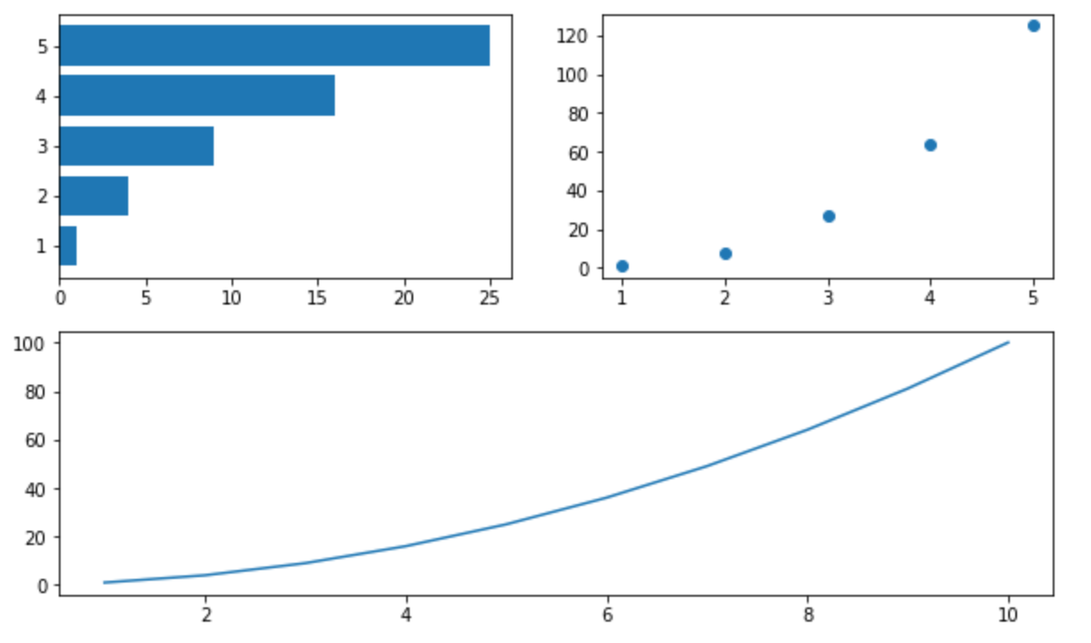
More about figure and axes
from matplotlib import pyplot as plt
import numpy as np
A1 = np.arange(1, 6)
A2 = np.arange(1, 11)
B = A1 ** 2
C = A1 ** 3
D = A2 ** 2
fig = plt.figure(figsize=(10,6))
ax1 = fig.add_subplot(221)
ax2 = fig.add_subplot(222)
ax3 = fig.add_subplot(212)
ax1.barh(A1,B)
ax2.scatter(A1, C)
ax3.plot(A2, D)
plt.show()

Slide 8
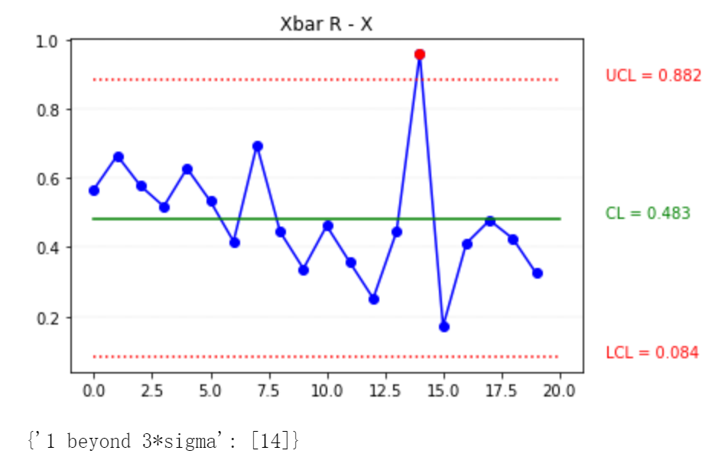
Home work
Draw a X-bar R control chart, try identify the point which over control limited

Slide 9


Author information
Bob Xie: Lenovo Senior SQE
If you interesting about Data analysis, can follow my column and WeChat
WeChat
column

